Slide 1
AccountChek® and Ellie Mae Encompass® Training

Slide 2
NOTE: In order to use the AccountChek services through the Encompass interface, your system admin has to enable AccountChek available to your company, and a login must be created for you by the AccountChek team.

Slide 3
User Setup

Slide 4
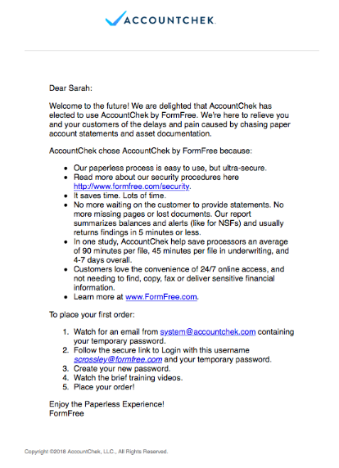
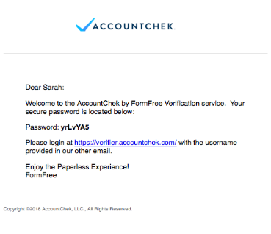
You will receive 2 emails once your account is created; one containing your username and the other containing a temporary password.
To create your own password, log in via the link in the second email.

Slide 5
The link in your second email will take you to the AccountChek login screen, where you will enter your username and the temporary password.

Slide 6
The first time you log in, you will be asked to create your own password. Once you have updated your password preferences, you may log in through Encompass.

Slide 7
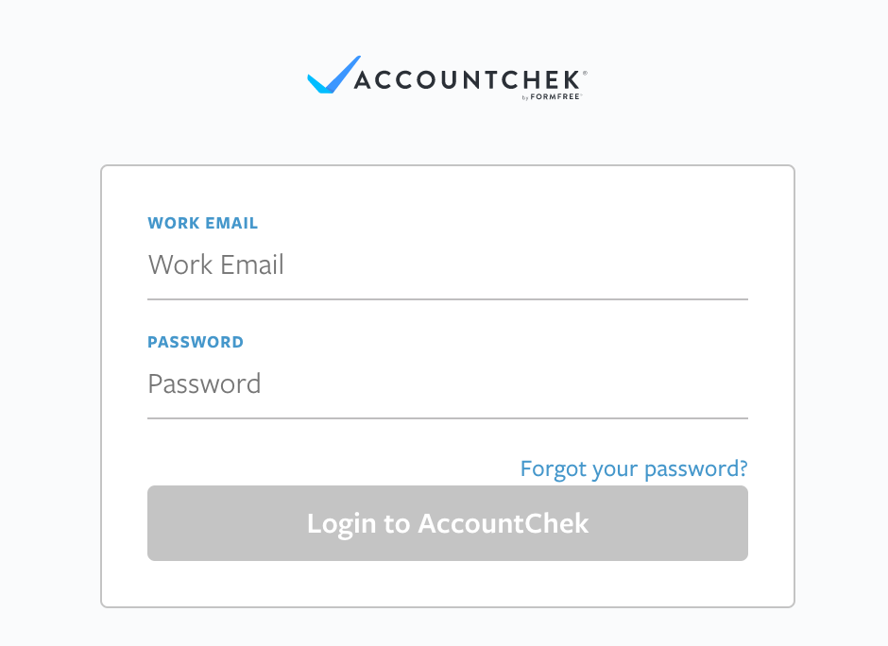
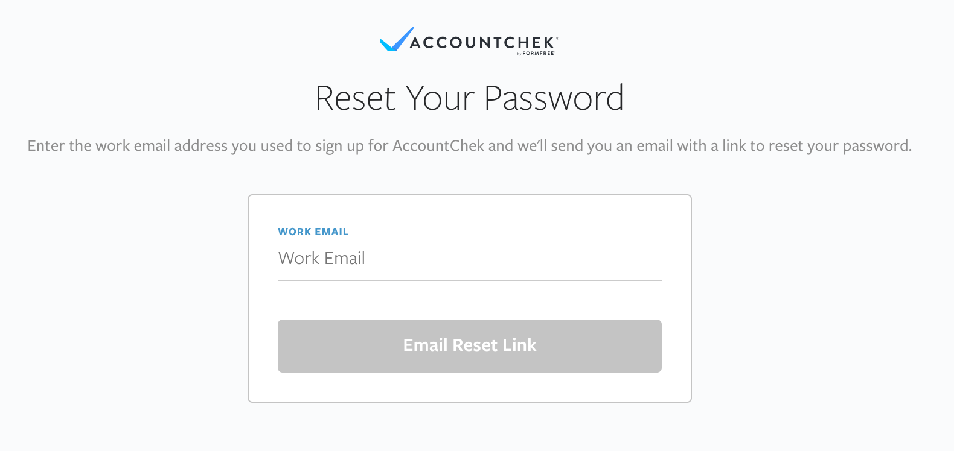
1.
2.
If you ever forget your password, click “Forgot Your Password?” on the login screen and enter your email address. You will be emailed a temporary password and asked to create a new permanent password.

Slide 8
Placing an Order

Slide 9
To locate the AccountChek integration within Encompass, select “Order Verifications” from the services tab.

Slide 10
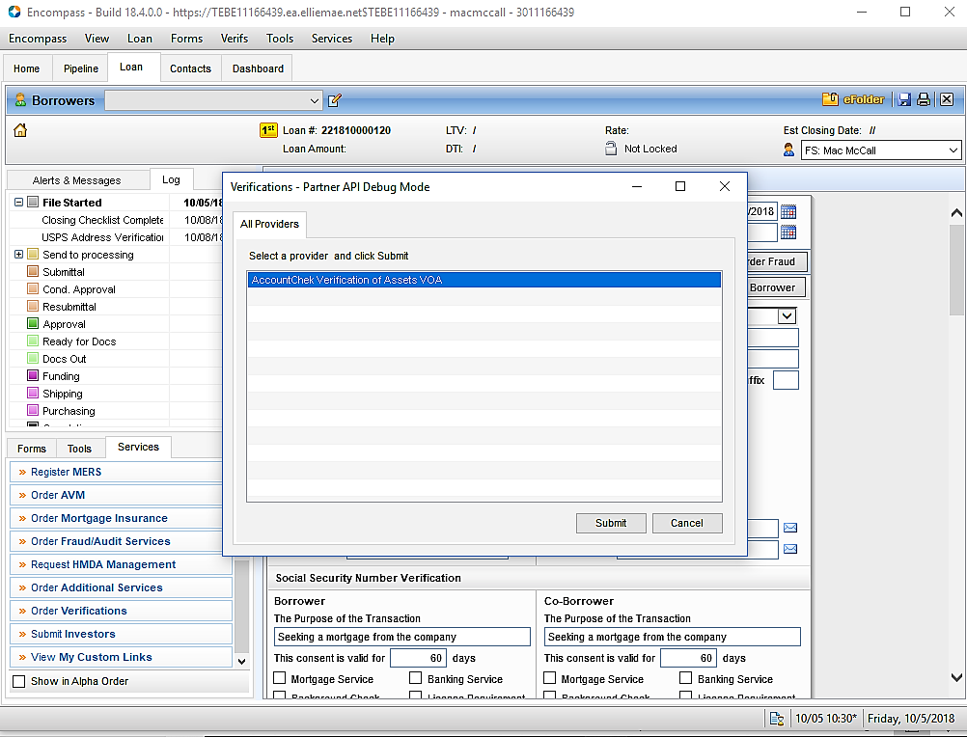
Choose “AccountChek Verification of Assets VOA" from your list of providers.
Notes:
Use old list of providers

Slide 11
To log in, supply your AccountChek Username and Password and click the Authorize button. Clicking “Remember Me” will retain your credentials. If you encounter any issues with your credentials, use the “Need Help? Click Here” button to contact our support team.
Notes:
Use blank login screen here.

Slide 12
When creating an order, First Name, Last Name, Last 4 of Social Security Number, Email, and Loan Number are required fields. Mobile number and Employer are optional. Clicking the “Copy from Borrower” or “Copy from Co-Borrower” buttons will auto-populate these fields with information from the borrower’s 1003.
Notes:
Potentially provide more info on employer and mobile number.

Slide 13
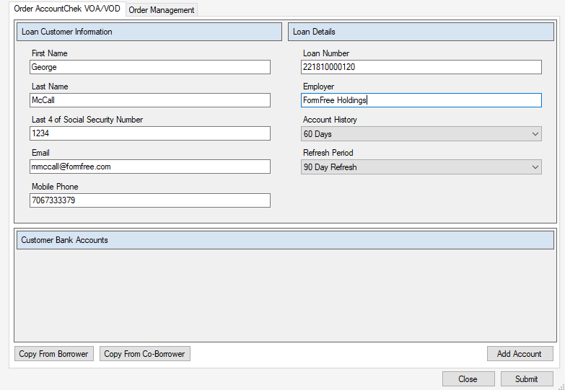
The Account History field determines how many days of history will be returned on the borrowers accounts. Choose 30, 60, or 90 days from the drop-down menu. Refresh Period determines how long the order will remain open after the borrower has initially linked their credentials. Similarly, choose 30, 60, 90, or one-time pull from the drop-down menu.
Notes:
Show drop-down menu?

Slide 14
If you are satisfied with the order as it currently stands, click “Submit” to trigger the AccountChek invite email to your borrower’s email address. Alternatively, if you would like to request specific accounts from your borrower, click the “Add Account” button.

Slide 15
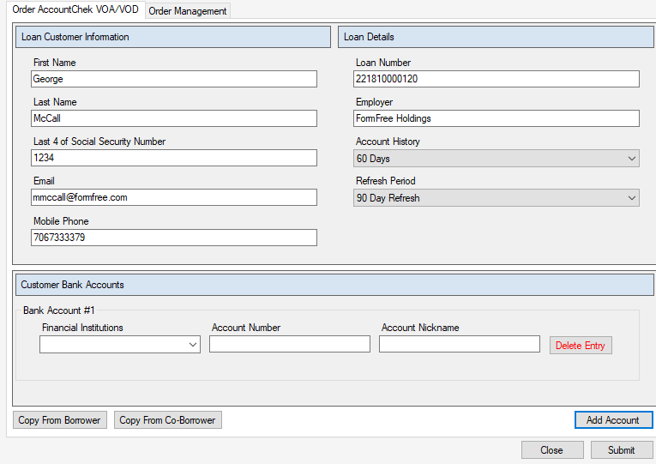
When requesting accounts from your borrower, select their financial institution from the drop-down menu in the “Financial Institutions” field. Account Number and Account Nickname are optional fields.
Notes:
Financial institutions.

Slide 16
By clicking the “Add Account” button you can continue to add additional accounts to the order. To delete one before placing the order, click “Delete Entry.”

Slide 17
If you do not supply an Account Number, your borrower will receive a request to link an account at the selected Financial Institution and will see a list of all accounts held in their name there. They can then select the correct one(s) to share with you.

Slide 18
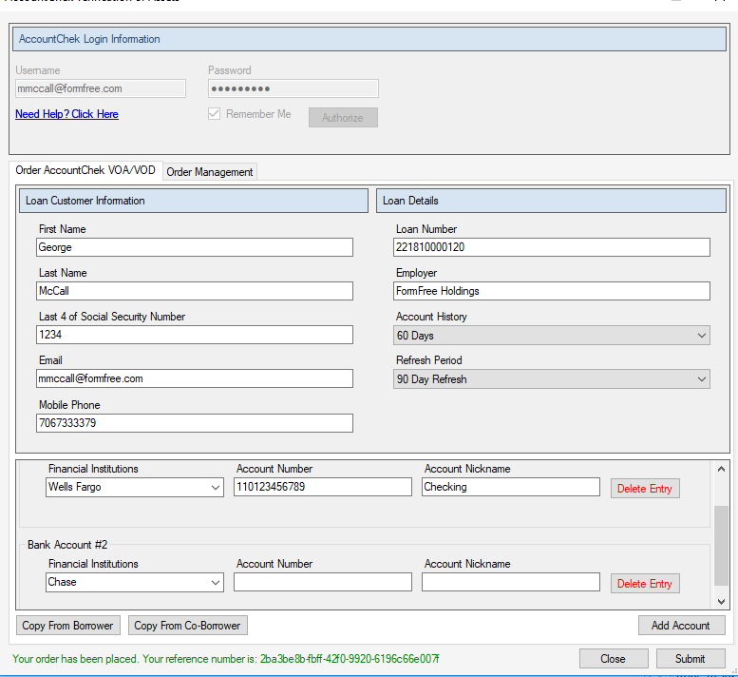
Once you have added all of the accounts you would like to request from your borrower, click “Submit.”

Slide 19
New Borrower Enrollment Process

Slide 20
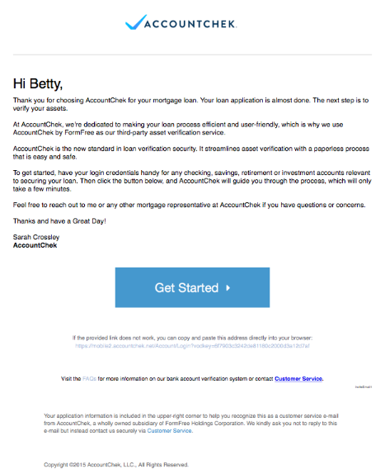
When you submit an order, the borrower will receive an email. The borrower selects “Get Started” to begin the login process.

Slide 21
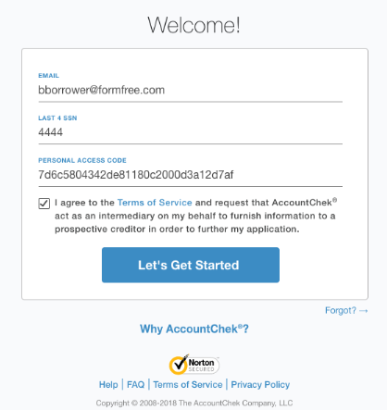
The borrower will next need to supply the last 4 digits of their SSN. The email address and personal access code will be auto-populated. After agreeing to the Terms of Service, they can log in to AccountChek.

Slide 22
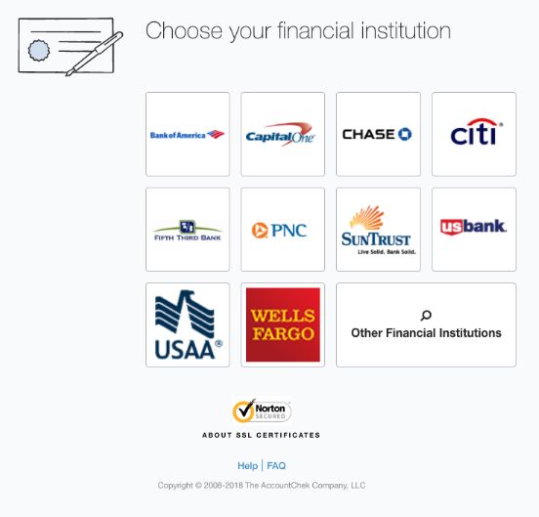
If no specific institution or accounts were requested of the borrower, they will have the option to choose from a list of popular institutions or search for their own using the “Other Financial Institutions” button.

Slide 23
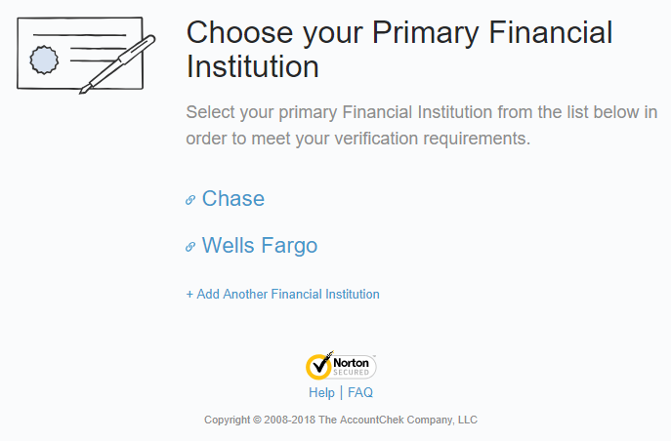
The borrower will be presented with a list of institutions you requested for verification. They can click on any FI listed to begin the verification process for that institution.

Slide 24
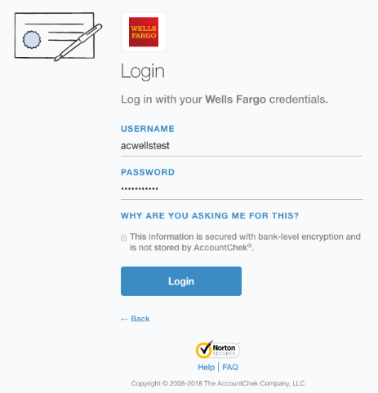
The borrower will link their account by entering their online banking credentials for the selected institution.

Slide 25
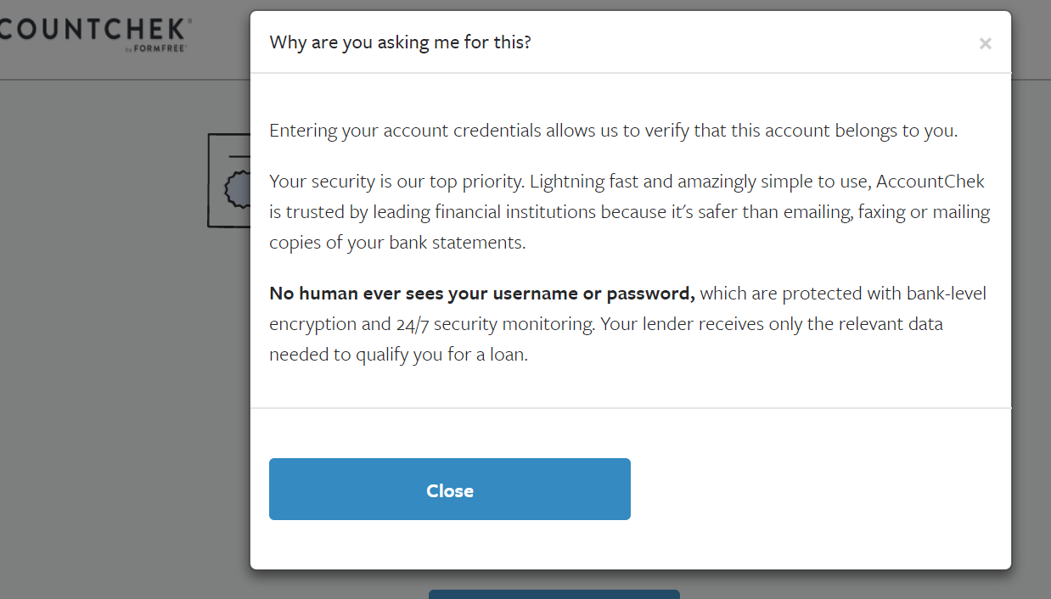
If the borrower clicks on the “Why are you asking me for this?” link, they can view some basic information on our security measures.

Slide 26
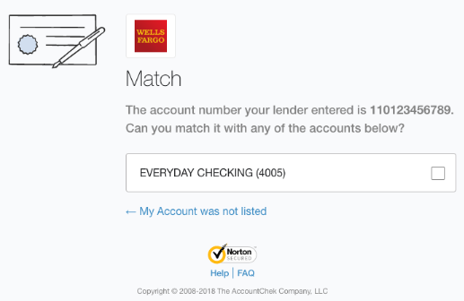
If a specific account was requested, the borrower will only see the option to verify that account. If you chose not to input the account number, the borrower will be able to view all accounts associated with the selected institution and will be able to select the correct one(s) to link.

Slide 27
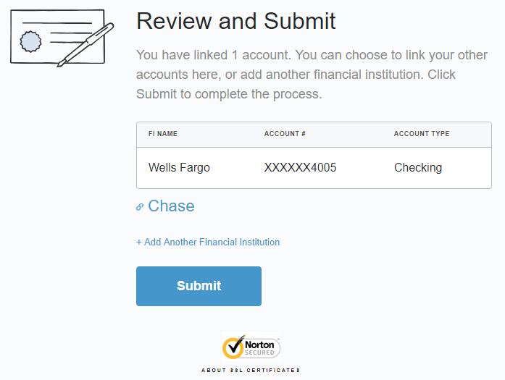
The borrower can choose to authorize another financial institution in the same manner as the first or select “Add Another Financial Institution” to link an account of their own choosing. Once they are finished, they can click ”Submit” to complete the verification process.

Slide 28
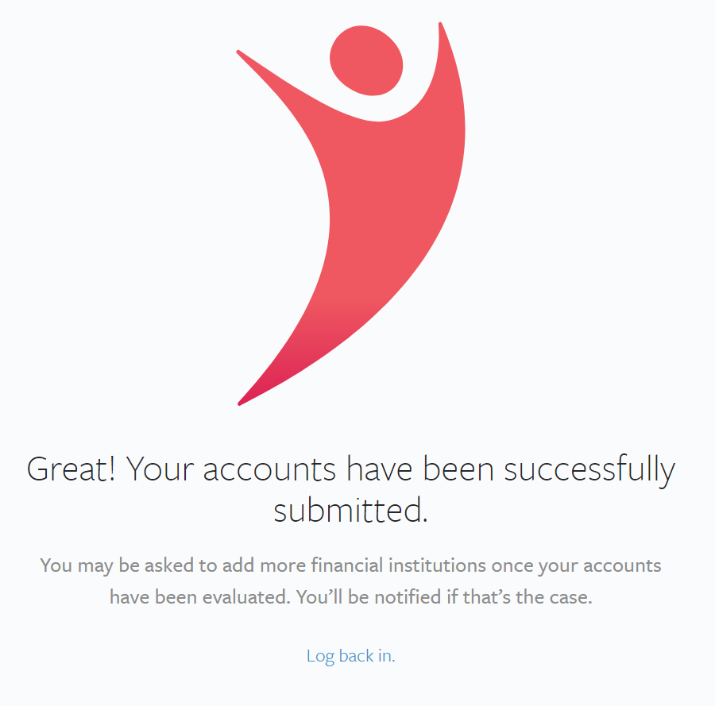
When the enrollment is complete, the borrower is automatically logged out of the AccountChek system.
The AccountChek report is automatically generated, and once it is ready to be retrieved, you will receive an email.

Slide 29
Managing Orders
And Retrieving Reports

Slide 30
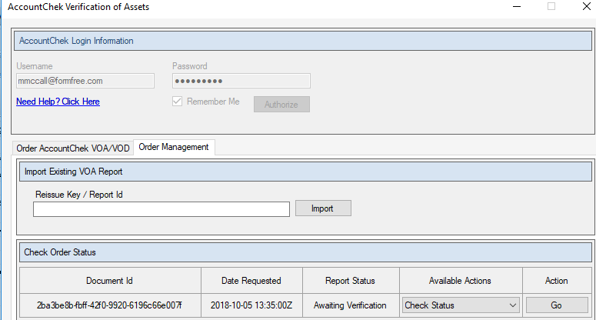
The Order Management tab displays all orders associated with the loan file. Selecting Check Status from the “Available Actions” tab and then clicking “Go” will provide you with updates on the status of the order.

Slide 31
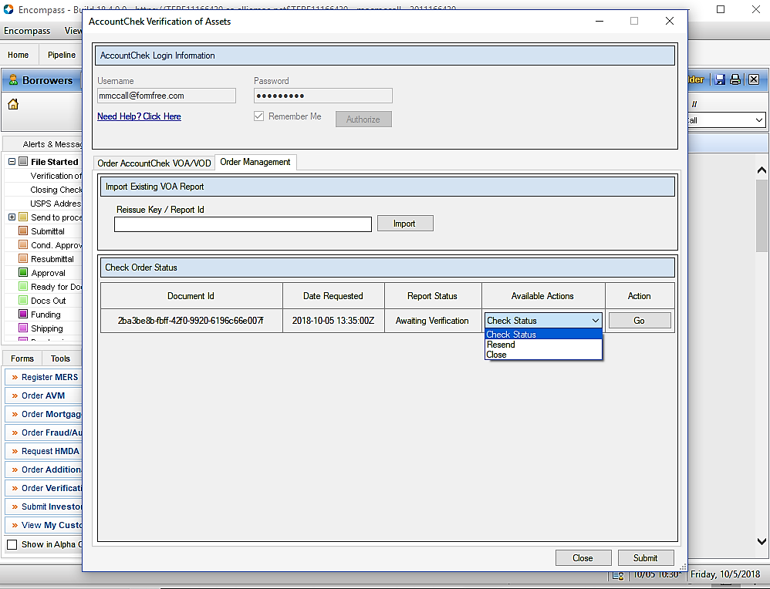
Hovering your mouse over the “Check Status” action button will provide detail about the borrower’s progress through the verification process.

Slide 32
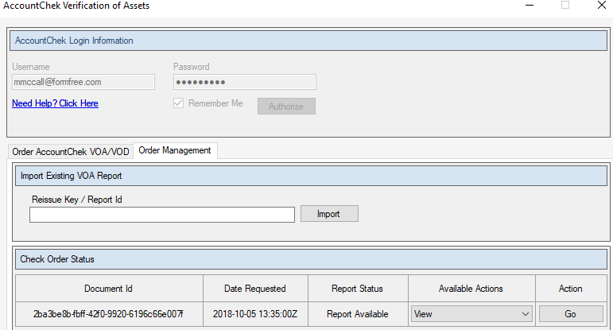
Once a report has generated, the “View” option becomes available in the drop-down menu, allowing you to view the Asset Report as a PDF.
Notes:
.pdf

Slide 33
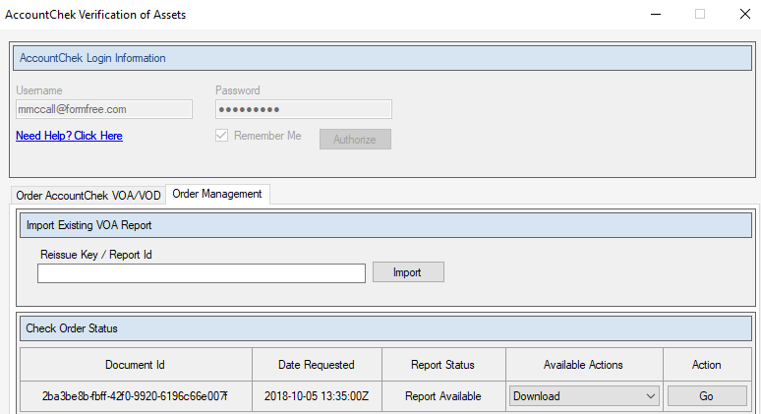
Once you have viewed the report, the “Download” button becomes available in the drop-down menu, allowing you to download the Asset Report directly to your Encompass eFolder.

Slide 34
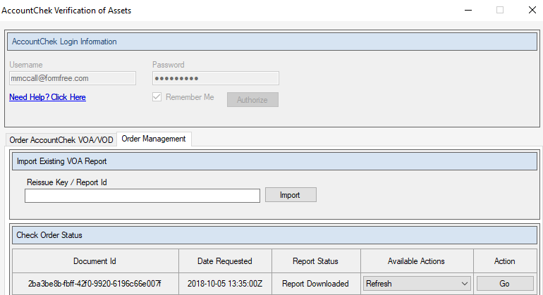
At any point after you have downloaded the initial report and the order is still open, the “Refresh” option will be available in the drop-down menu, allowing you to generate a completely updated report.

Slide 35
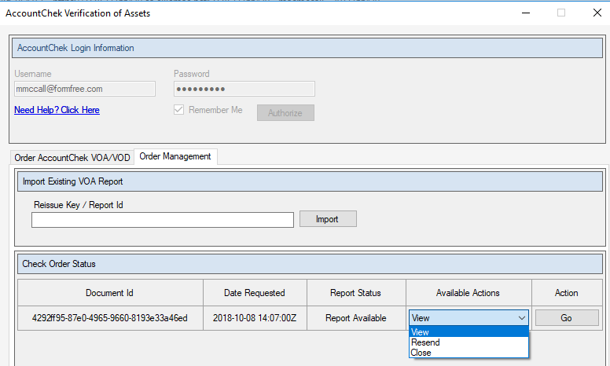
There are two other actions available in the drop-down menu. If your borrower has lost their initial invite email, select “Resend” and press “Go” to trigger another one. If you need to close out the order before the refresh period has ended, choose “Close” and press “Go”.

Slide 36
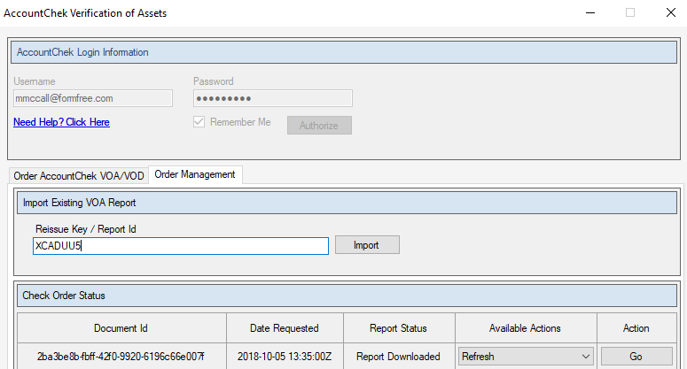
To import a report initially placed outside of the Encompass integration, supply the Reissue Key or Report ID of the report in question and click “Import.”

Slide 37
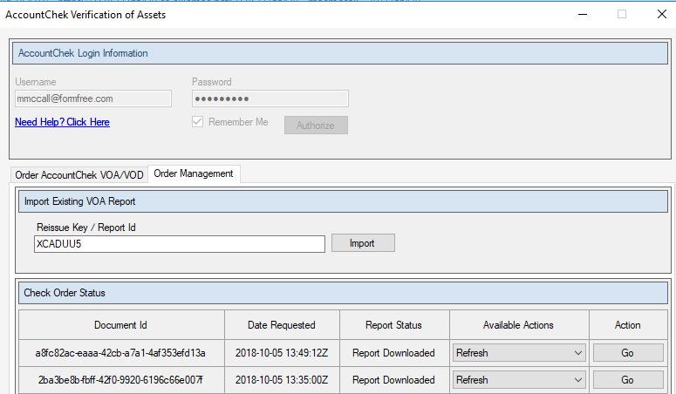
This will associate the report with the loan file, allowing you to manage it from Encompass.

Slide 38
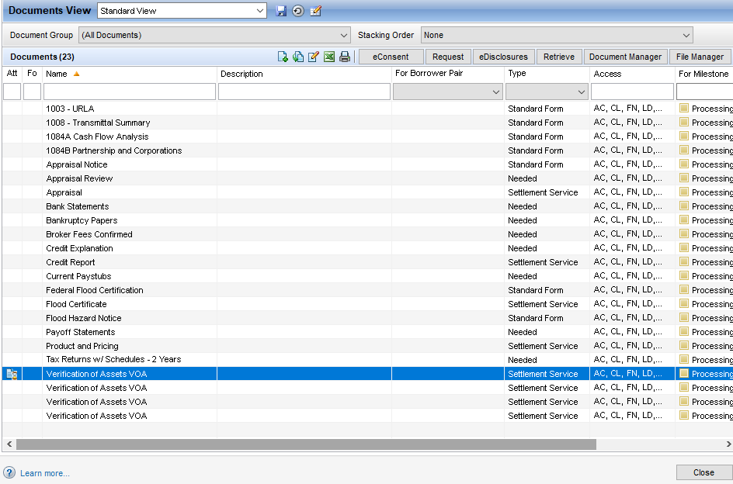
Downloaded reports will be placed into your eFolder under Verification of Assets.

Slide 39
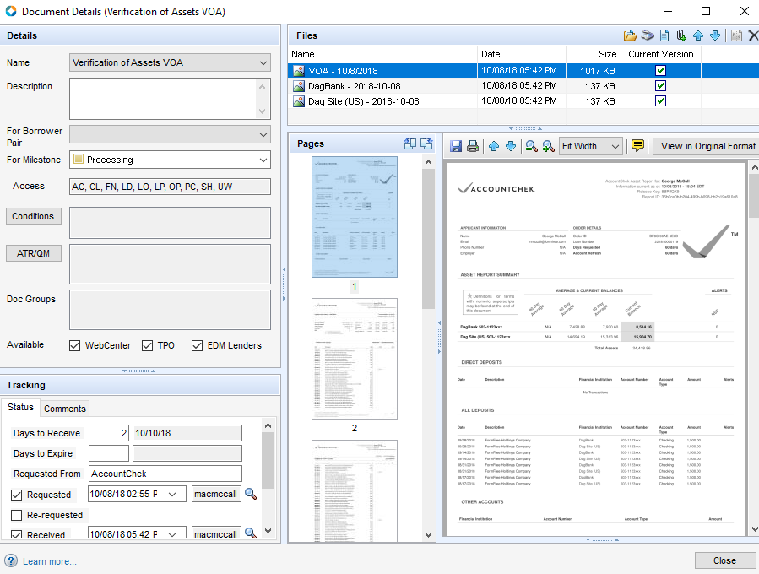
Each Verification of Assets file will contain an Asset Report along with VODs for each of the accounts included on the report.

Slide 40
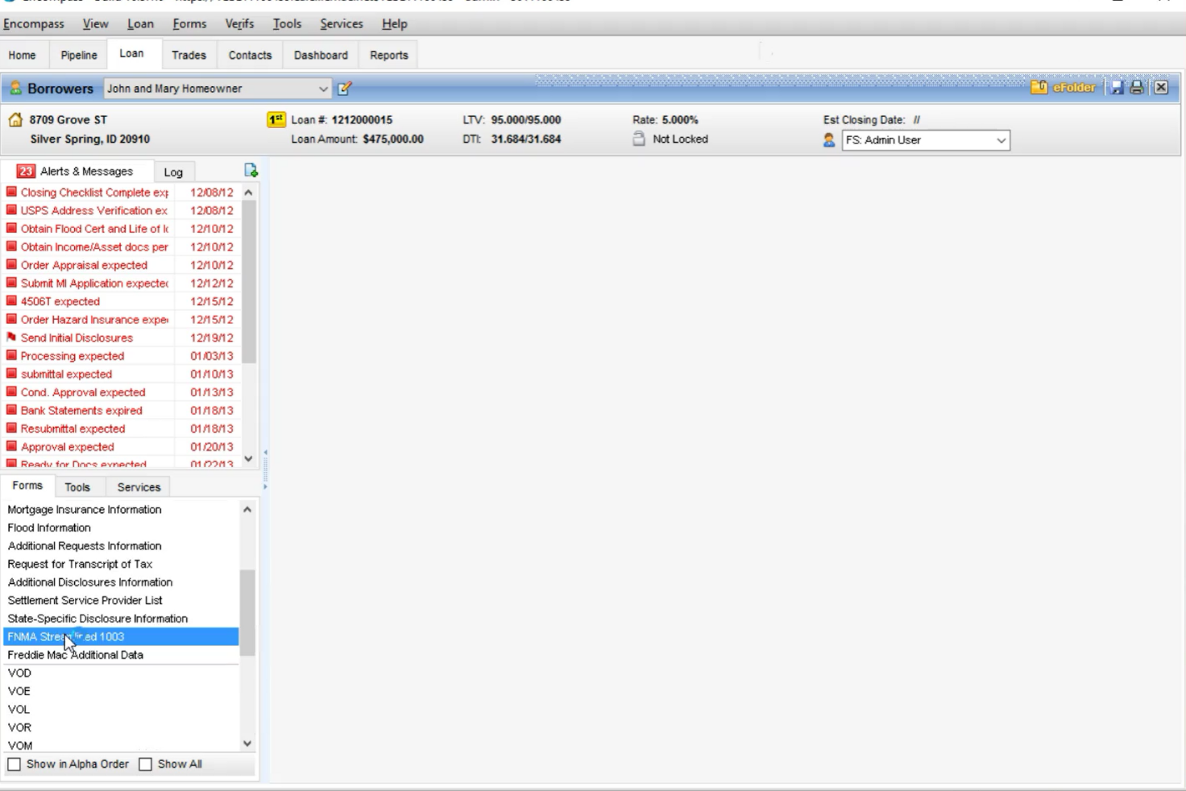
If you are selling the loan to Fannie, select “FNMA Streamlined 1003.”

Slide 41
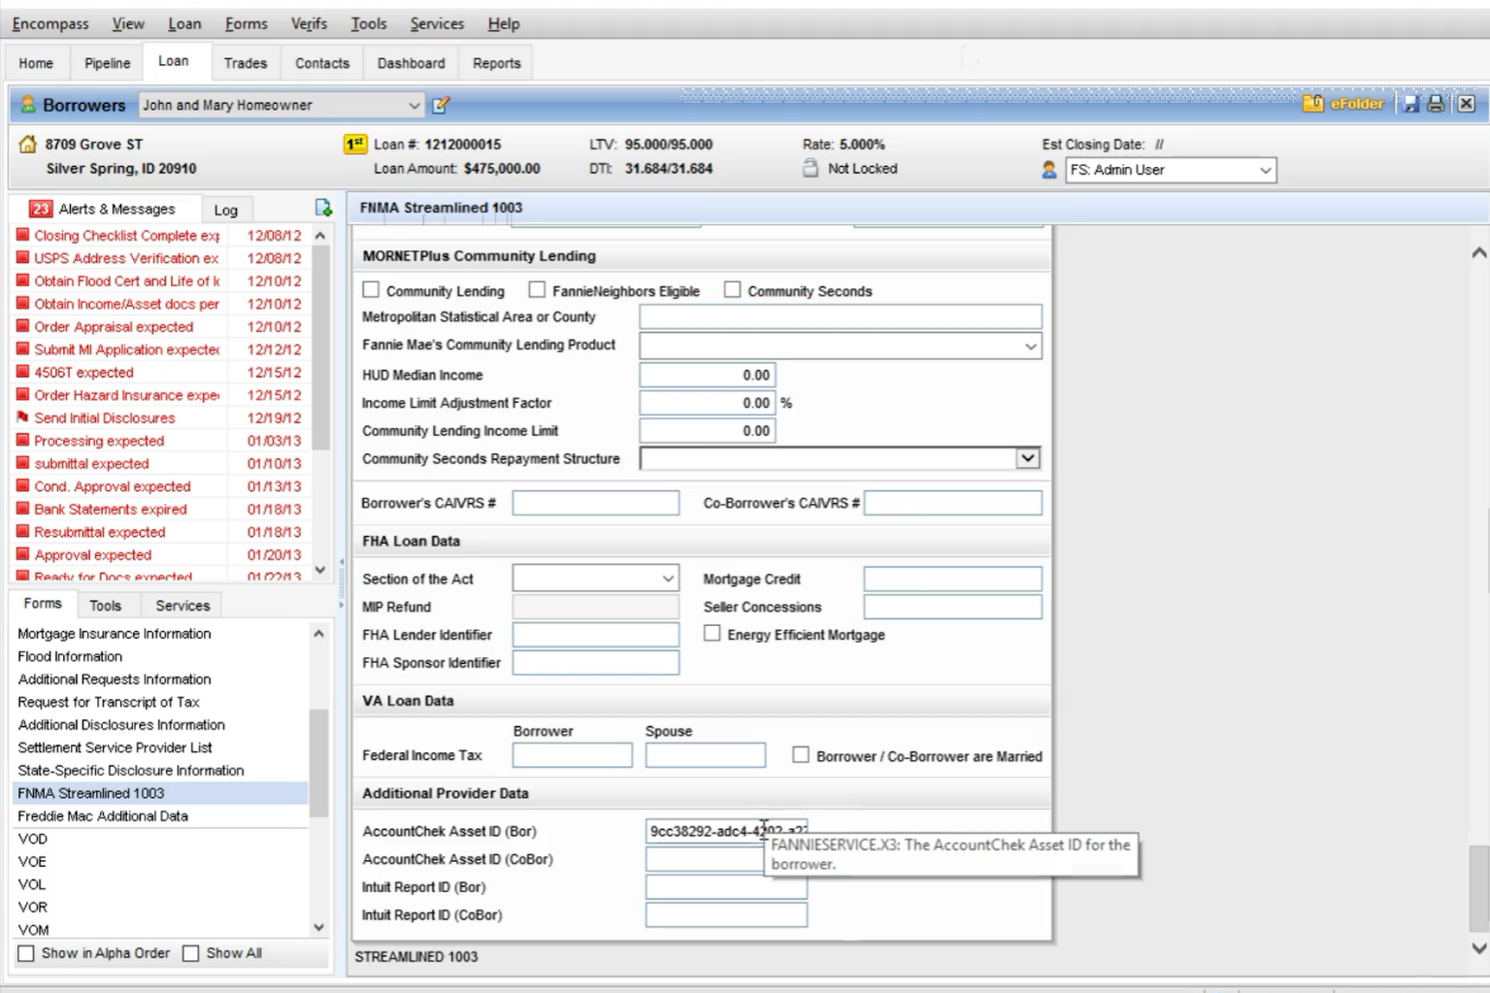
The Reissue Key/Report ID associated with the Asset Report will auto-populate into the “AccountChek Asset ID” field.

Slide 42
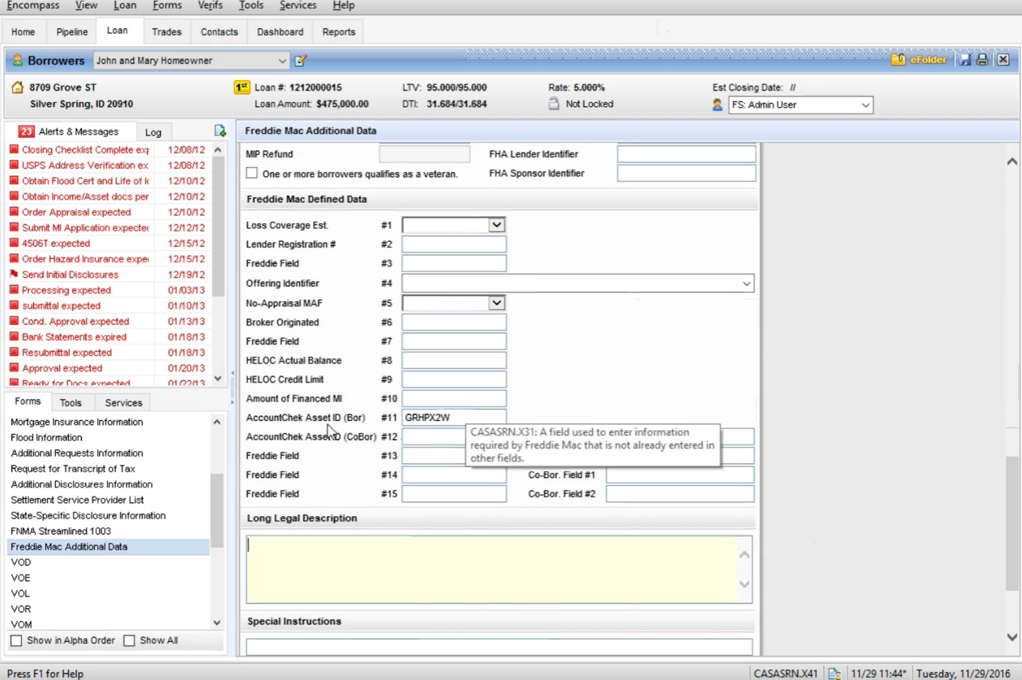
If you are selling the loan to Freddie Mac, the Reissue Key/Report ID will auto-populate into the “AccountChek Asset ID” field in the Freddie Mac Additional Data form as well.

Slide 43
Adding and Removing Accounts
Notes:
Bank level Security
2048 bit encryption protection for data in transit and at rest
Our servers are protected by multiple firewalls and all communications are secured with TLS 1.2
Ongoing audits and certifications
SSAE 16 SOC2 Type II Attestations
Cloud Security Alliance CAI Audited
ISO/IEC 27001:2015 Certification
Fannie Mae’s Day1 Certainty
Read-only product
Cannot and will not make changes to borrower’s accounts.

Slide 44
To manage accounts included in a report, go to verifier.accountchek.com and supply your login credentials.

Slide 45
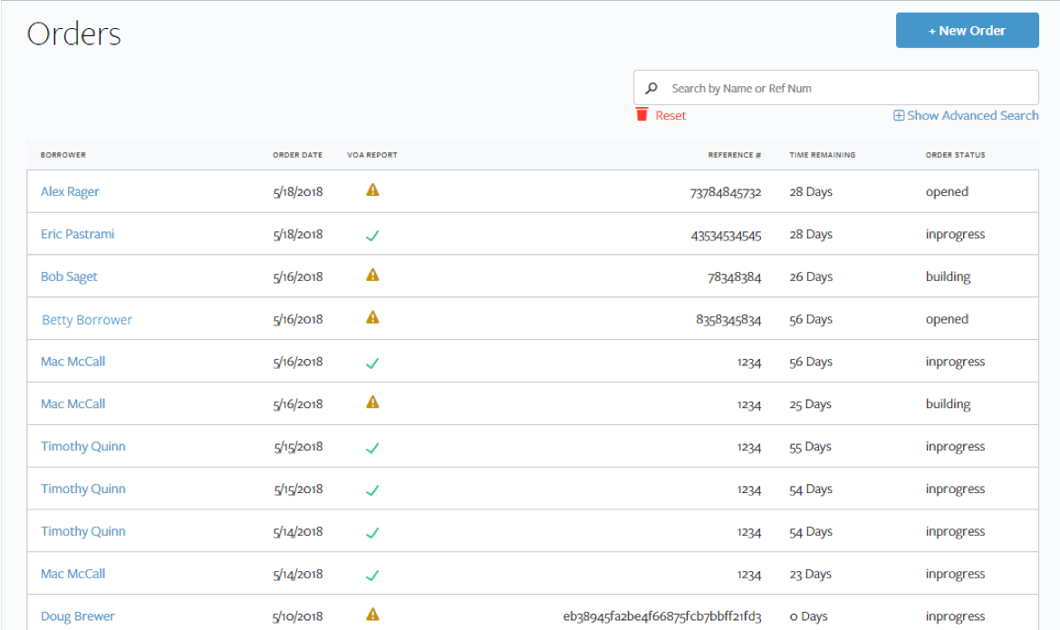
Clicking on “Orders” will display all of your orders. You can search the list by the borrower name or reference number, or use the Advanced Search function to search by status and/or date.

Slide 46
Clicking on the name associated with an order will open a page allowing you to view more detailed information.

Slide 47
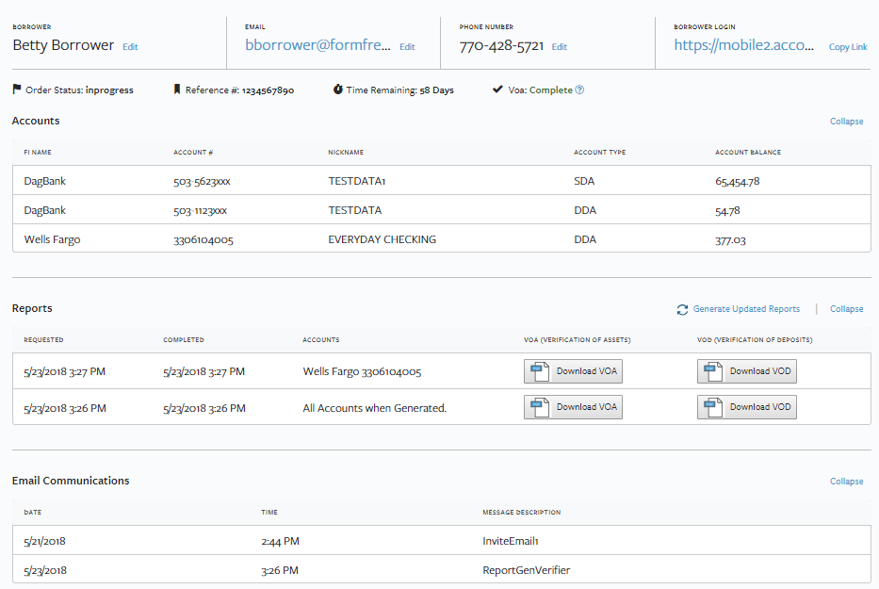
To generate updated reports and/or manage accounts on the report, select the “Generate Updated Reports” button.

Slide 48
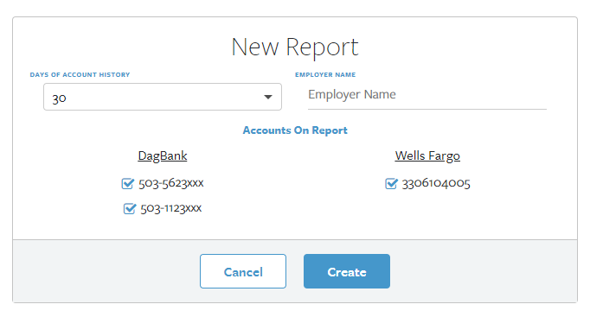
This will allow you to generate a completely updated Asset Report according to your own preferences. “Days of Account History” allows you to change the days of history included in the report. If you did not input Employer name previously, you can do so here.

Slide 49
You can manage accounts included on the updated Asset Report by simply checking or unchecking the box associated with each account.

Slide 50
Click the “Create” button to generate an updated report with only the checked accounts included.

Slide 51
There are 2 ways to pull the updated report into Encompass:
Use the “Download VOA” or “Download VOD” buttons to download the verifications in .pdf form and upload to your eFolder.
Enter Encompass and select the refresh button, The changes made to the parameters on the report in the dashboard will be reflected in Encompass.

Slide 52
Understanding Reports

Slide 53
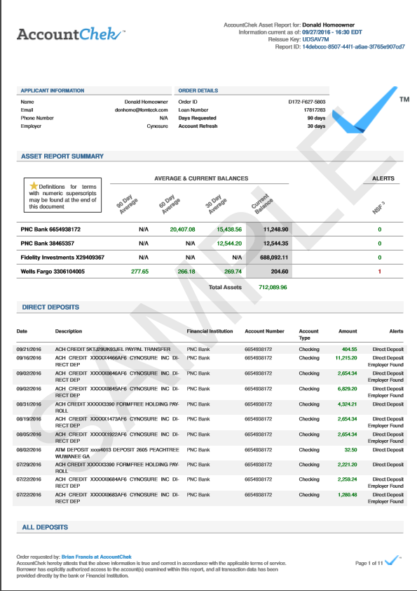
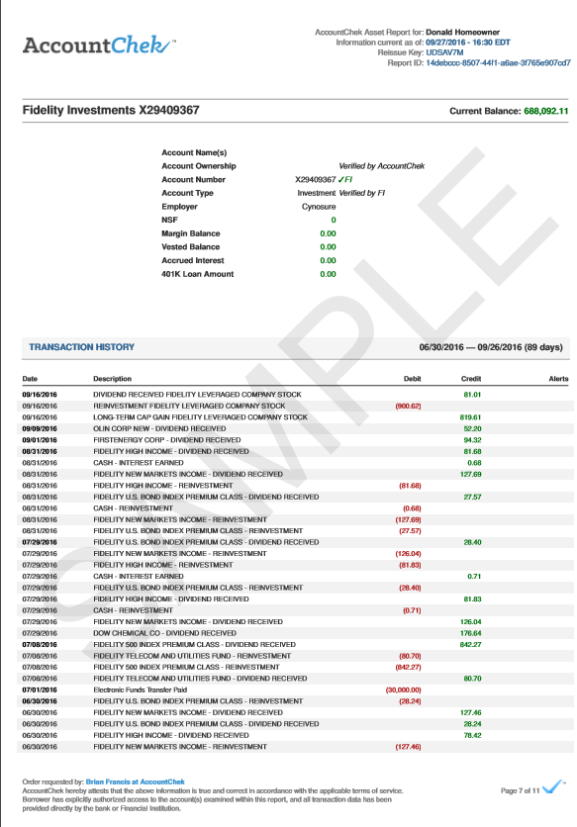
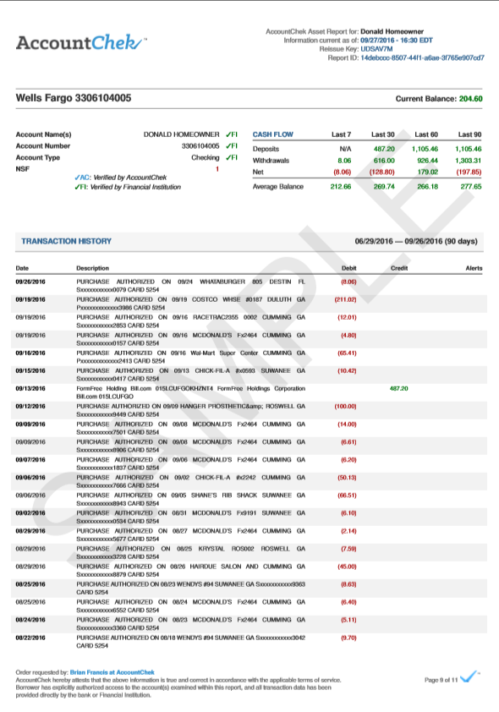
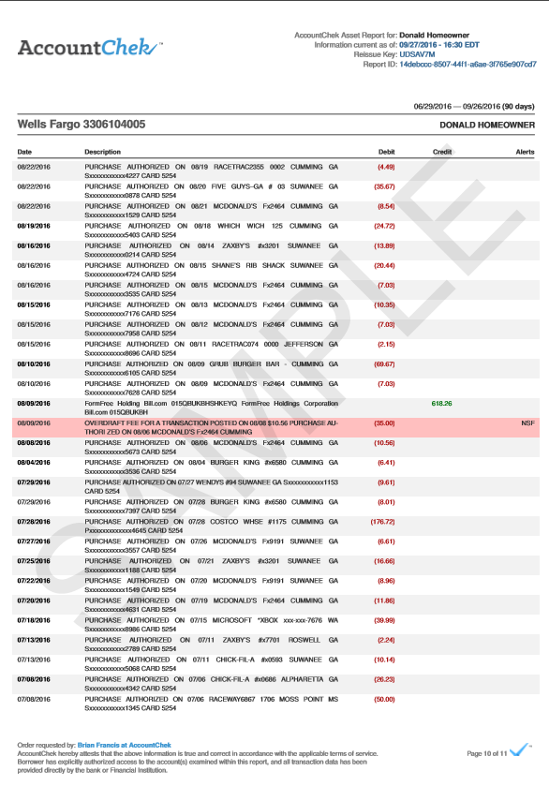
All Financial Institutions (and all shared accounts) with their respective transaction histories are contained in one Asset Verification report, along with AccountChek proprietary analysis.

Slide 54
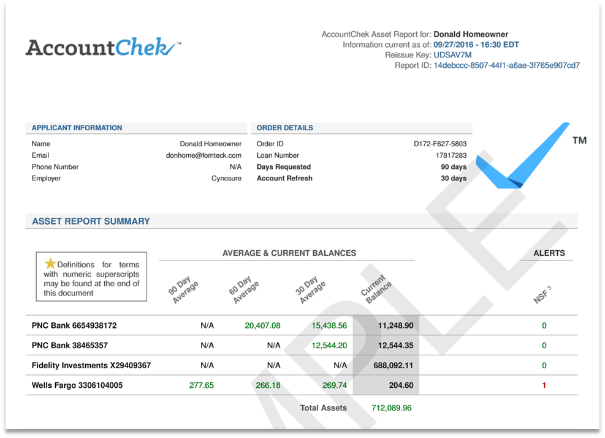
The header shows the Applicant Name, Date and Time Stamp for the report generation, Reissue Key and Report ID. On the first page, you will also see a list of all accounts and their respective current and average balances.

Slide 55
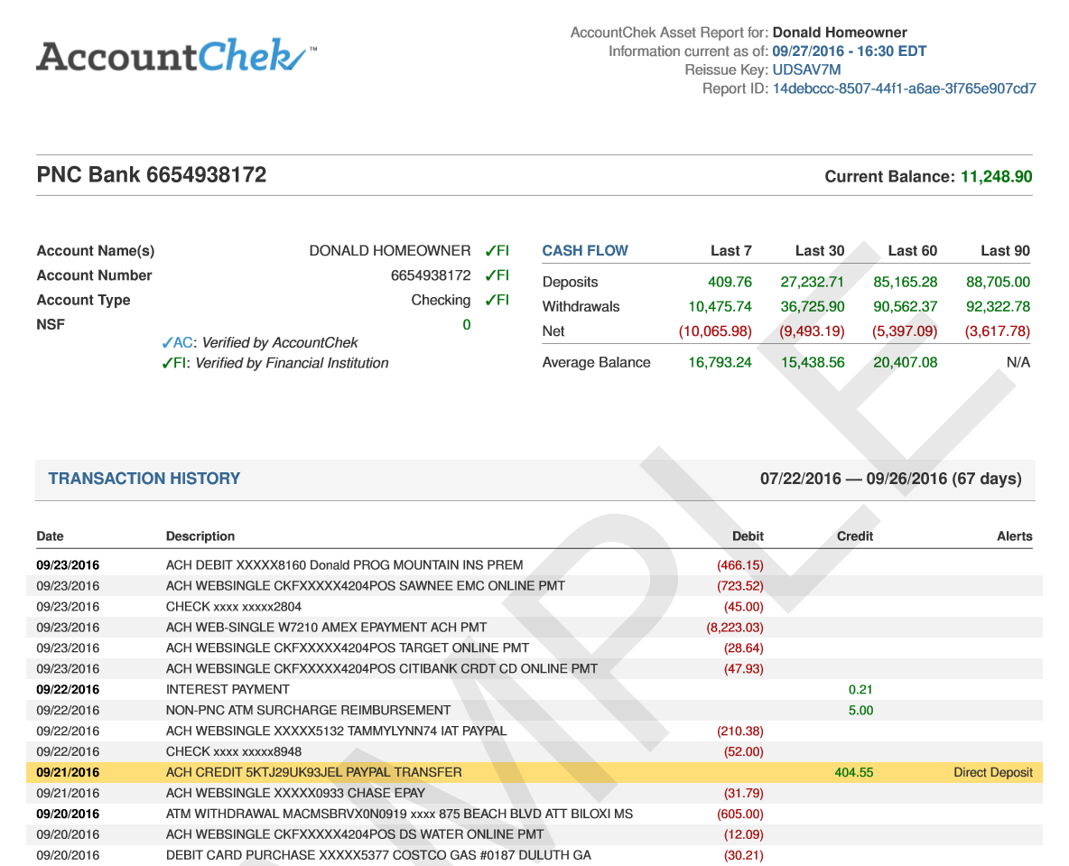
Each account shared by the borrower compares 1003 data with data reported by the financial institution. The “Transaction History” includes highlighted standard and ACH Direct Deposits, Employer and flagged NSFs.

Slide 56
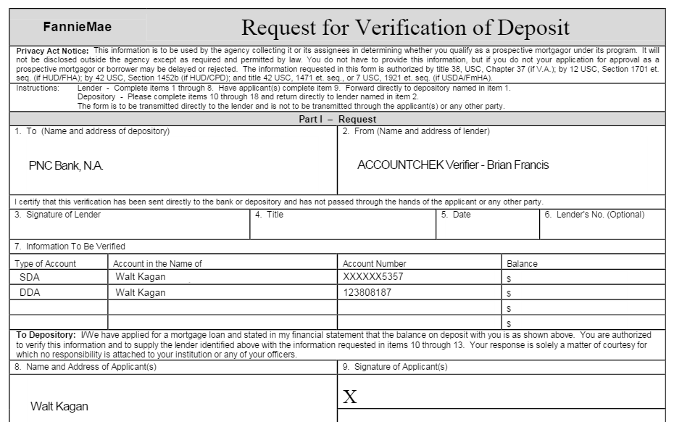
The VOD Report format follows the standardized 1006 Fannie Mae layout.

Slide 57
Customer Support Information
Customer Support Hours:
9am-9pm ET
Monday-Friday
Customer Service Desk:
helpdesk@accountchek.com
800-225-9498

